Slide 1
Variational Autoencoders

Slide 2
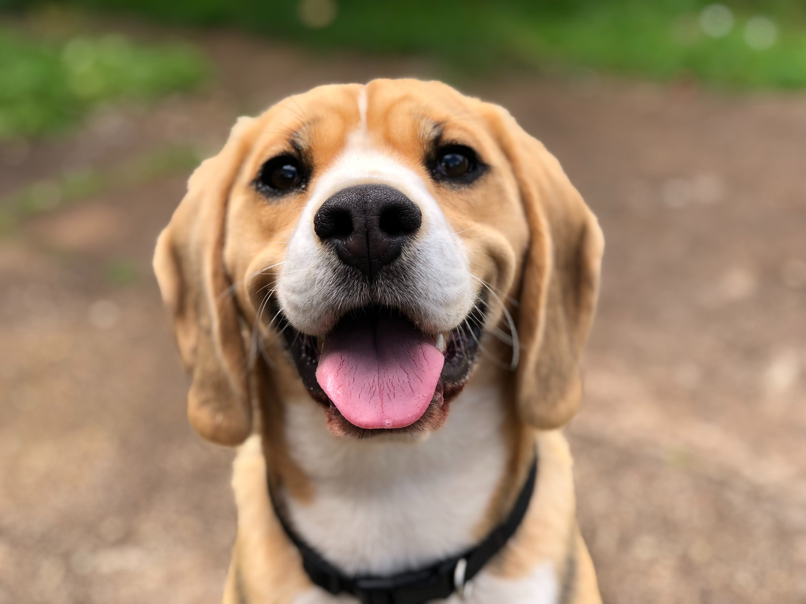
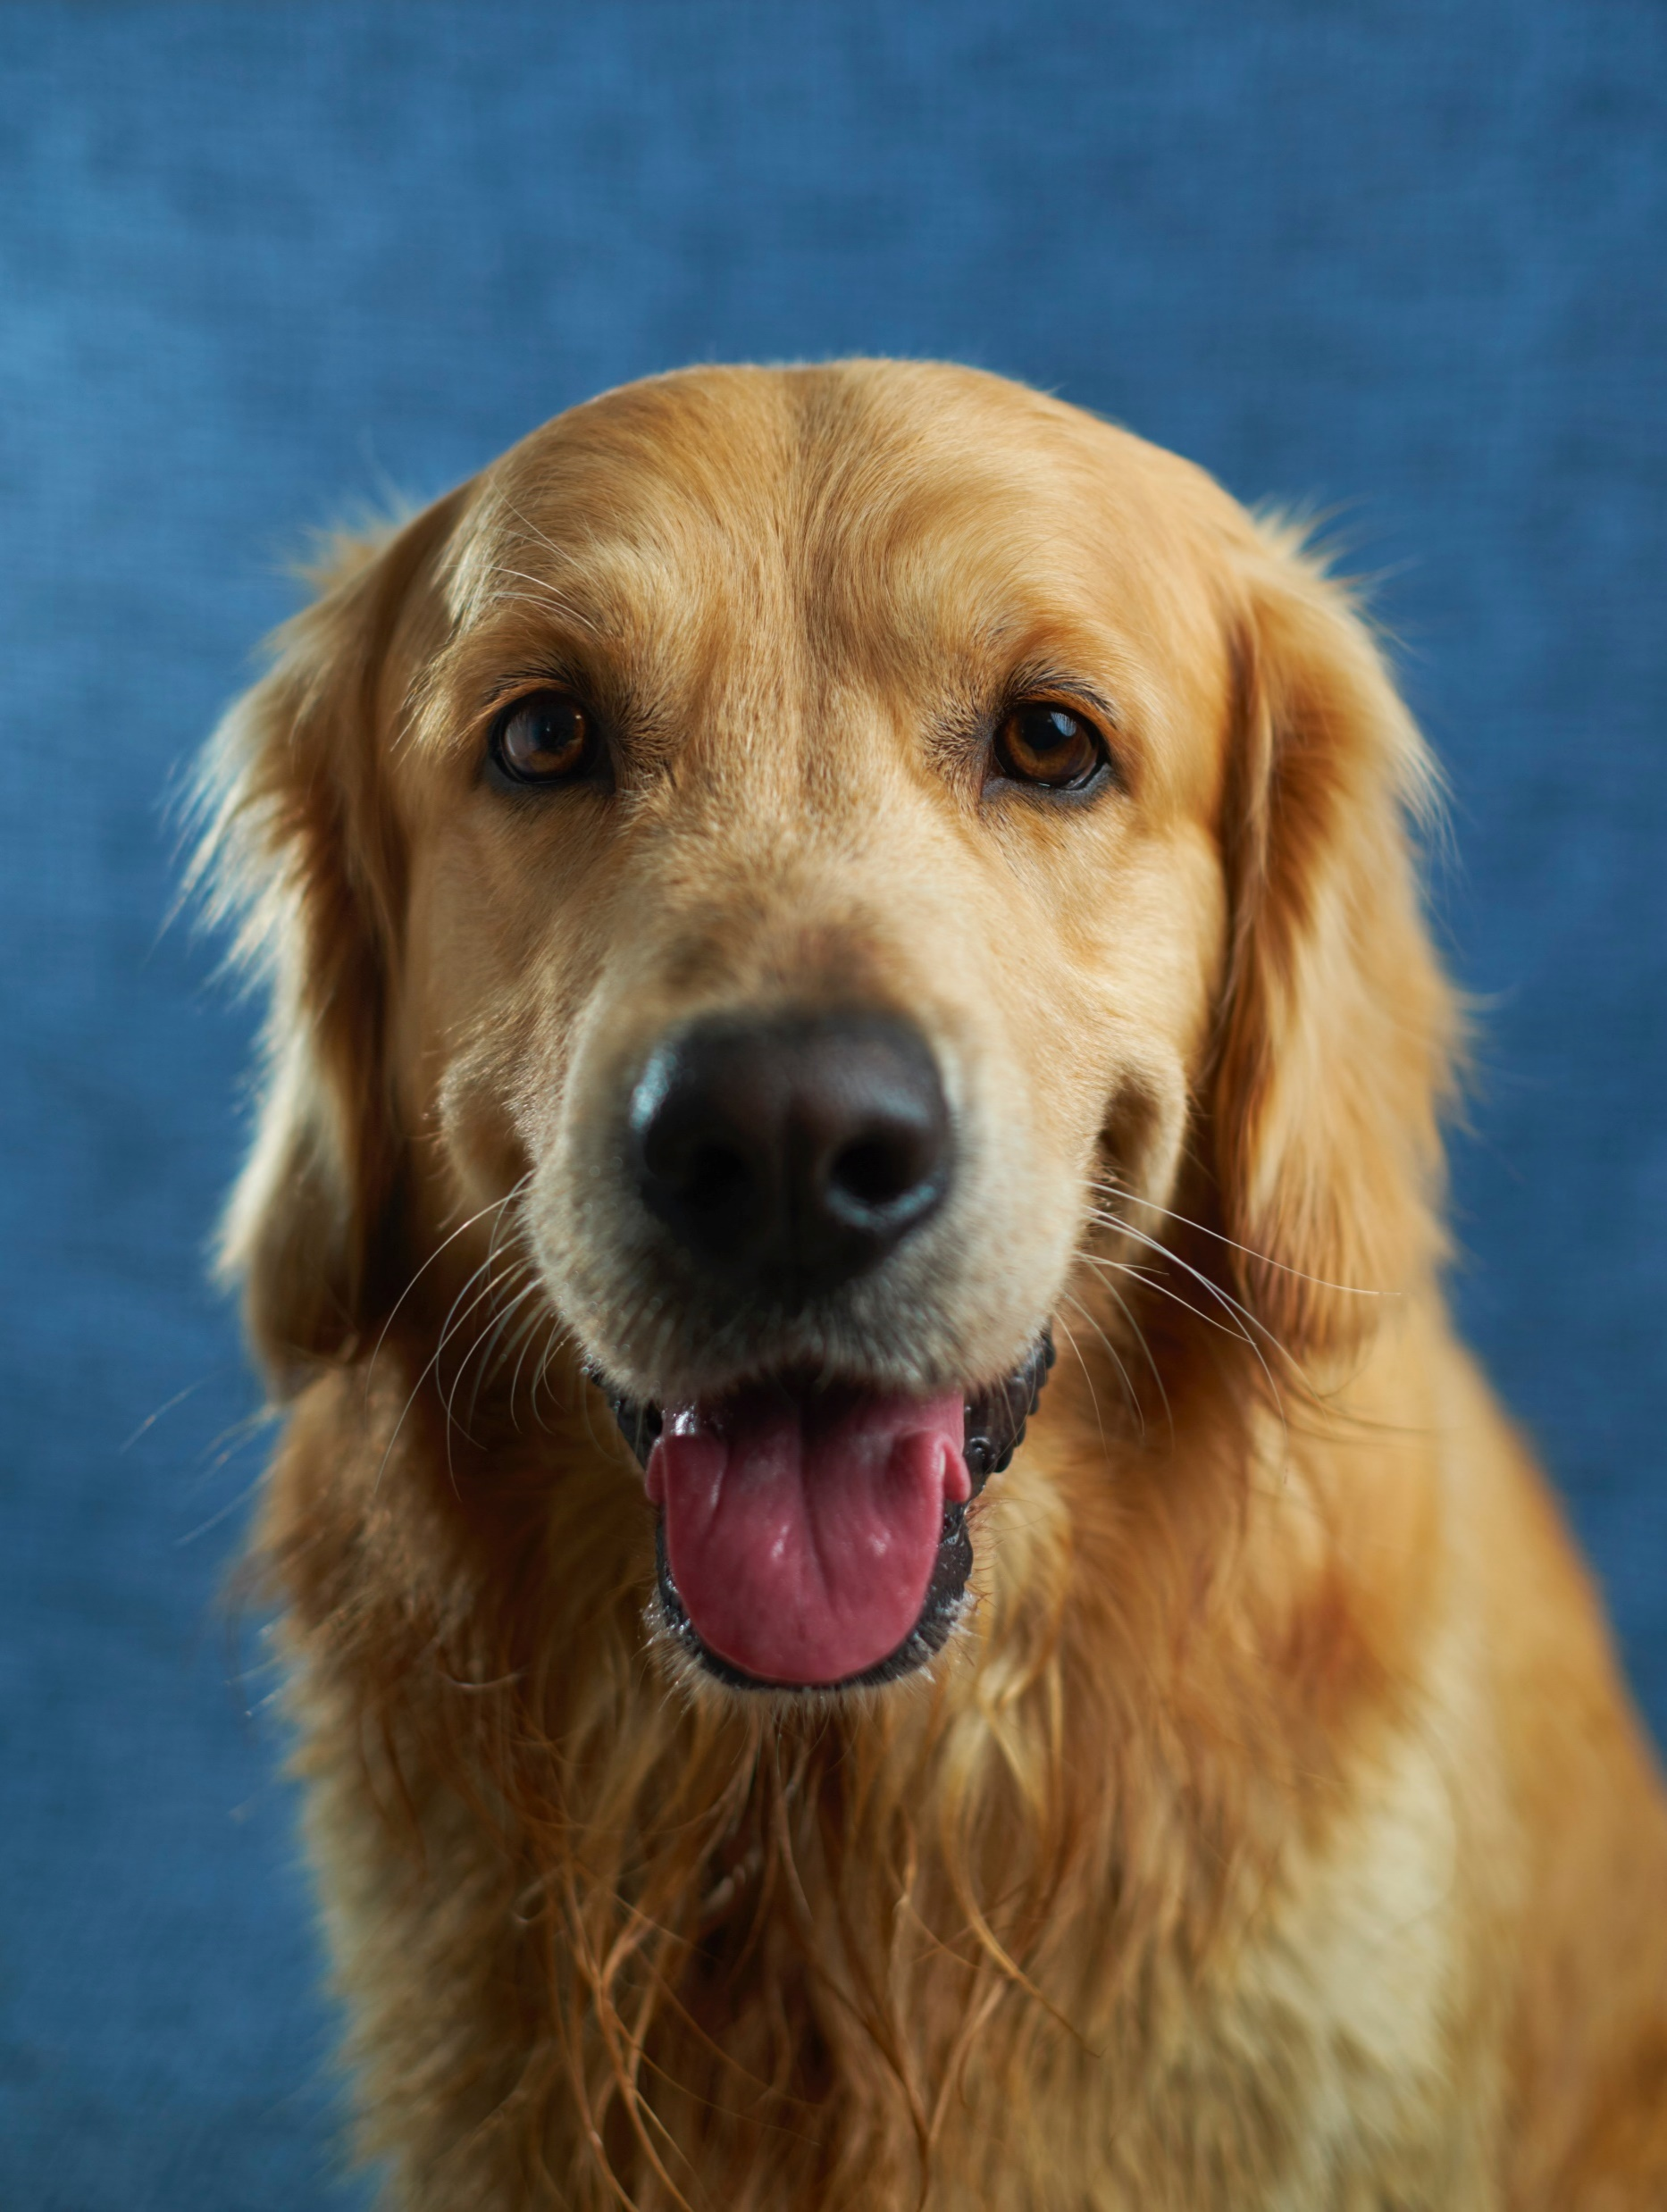
Generative Model
Neural
Network
Alt text:
A dog opening the mouth
Generative
Model
Notes:
Nowadays we are all familiar with neural network
One of its common task is like when we give it a picture, it will automatically generate the alternative text for this picture.
But for generative model, what we want more is usually not the text.
When we feed the model with a set of dogs’ pictures, we want the model to generate some more dogs that are similar to the input but not 100% same.
To achieve this goal, let’s first introduce the autoencoder model.

Slide 3
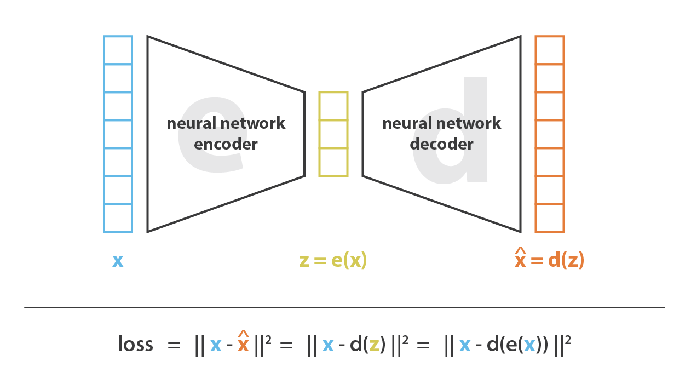
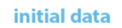

Autoencoder
Source: Understanding Variational Autoencoders (VAEs)
Notes:
It consists of two parts.
The encoder nn and the decoder nn
So you first get your input data, it can be audio, video, pictures, and for us maybe a transaction record, with the transaction amount, trade date and customer info.
Then it will get a set of middle factors, or called latent vectors.
It may represent some certain features of the input data, but like all the neural net works it will be hard to interpret these features.
Then through the right part, the decoder part, the middle factors will be decoded.

Slide 4
Autoencoder
Notes:
The training process is just to make the output more and more close to the initial inputs.
So at this time a question may be asked. Why are we doing this. Why are we trying to generate a picture just the same as the input

Slide 5
Autoencoder
Notes:
What we care about is the factors in the middle
It is the representation of the input, or to say that is the real input that computer actually understand.

Slide 6
Autoencoder
Notes:
If we want to generate some new things, here like we want to generate some new dog pictures, we need to give the decoder some data,
But generally we have no idea of the natures of these features

Slide 7

Autoencoder
3.74
-28.43
-394
0.83
-5.52
9.45
192
Notes:
so what we can do is we randomly generate some data
the result is likely we will not get a picture we want but end with a picture we human cannot understand
That means a traditional autoencoder cannot work well as a generative model

Slide 8
Autoencoder
Sampling from a distribution
Notes:
So in order to get an output we want, what we try to do is to sample the data from a distribution.

Slide 9
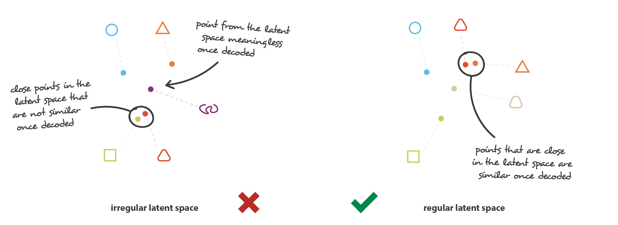
Source: Understanding Variational Autoencoders (VAEs)
Notes:
Rectangle and triangle with round angles.

Slide 10
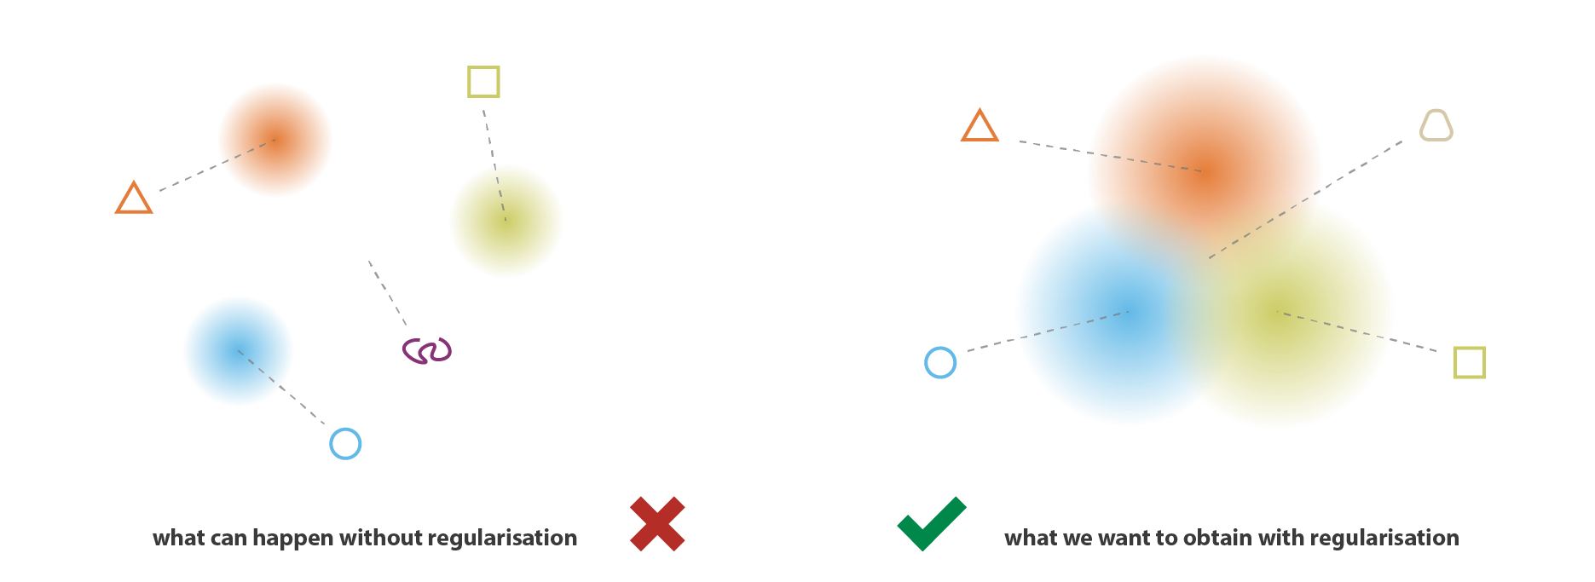
Source: Understanding Variational Autoencoders (VAEs)

Slide 11
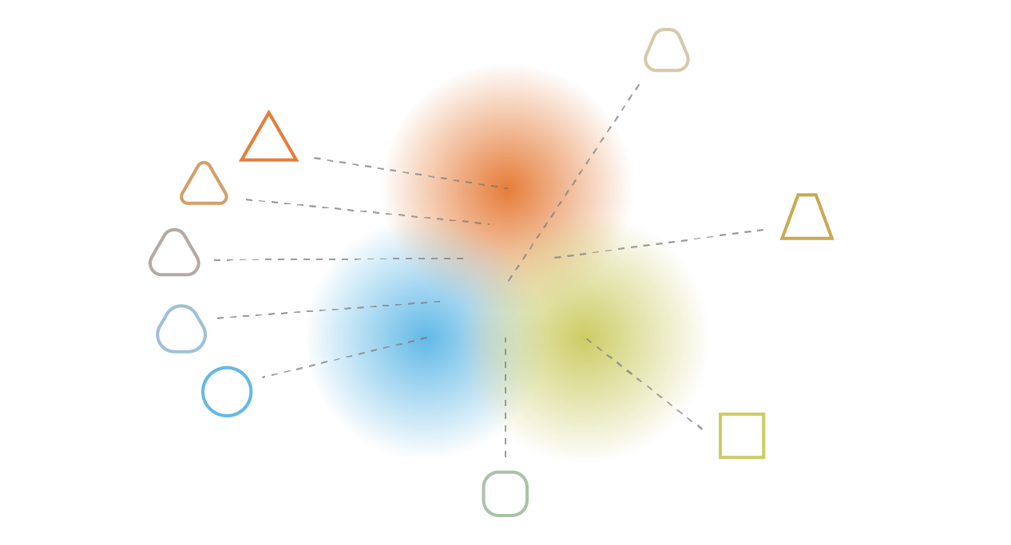
Source: Understanding Variational Autoencoders (VAEs)

Slide 12
Variational Autoencoder

Slide 13
Autoencoder
Notes:
In autoencoder the encoded data is immediately generated by the neural network

Slide 14
Variational Autoencoder
Z ~ P(Z|X)
Z ~ N(μ, σ)
Notes:
instead of encoding an input as a single point, we encode it as a distribution over the latent space.
That means, we will first learn a distribution from x, and then sampling z from the learnt distribution.
In practice, the encoded distributions are chosen to be normal so that the encoder can be trained to return the mean and the covariance matrix to help us describe the distribution

Slide 15
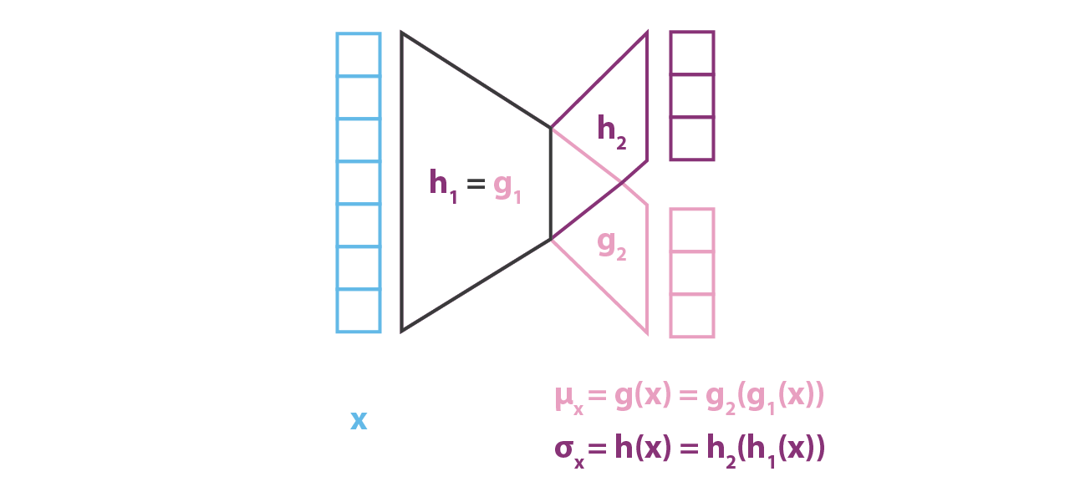
Variational Autoencoder
μ
σ
Notes:
That means now what we need to learn from x is two parameters.
One is the μ, which is the mean of the distribution
Another is sigma, which is the covariance matrix.

Slide 16
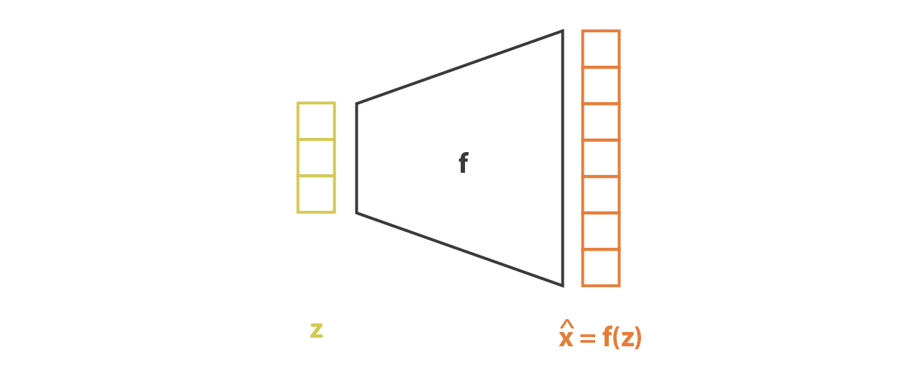
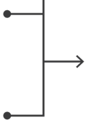
Source: Understanding Variational Autoencoders (VAEs)
Notes:
But the process is little bit complex in the vae.

Slide 17
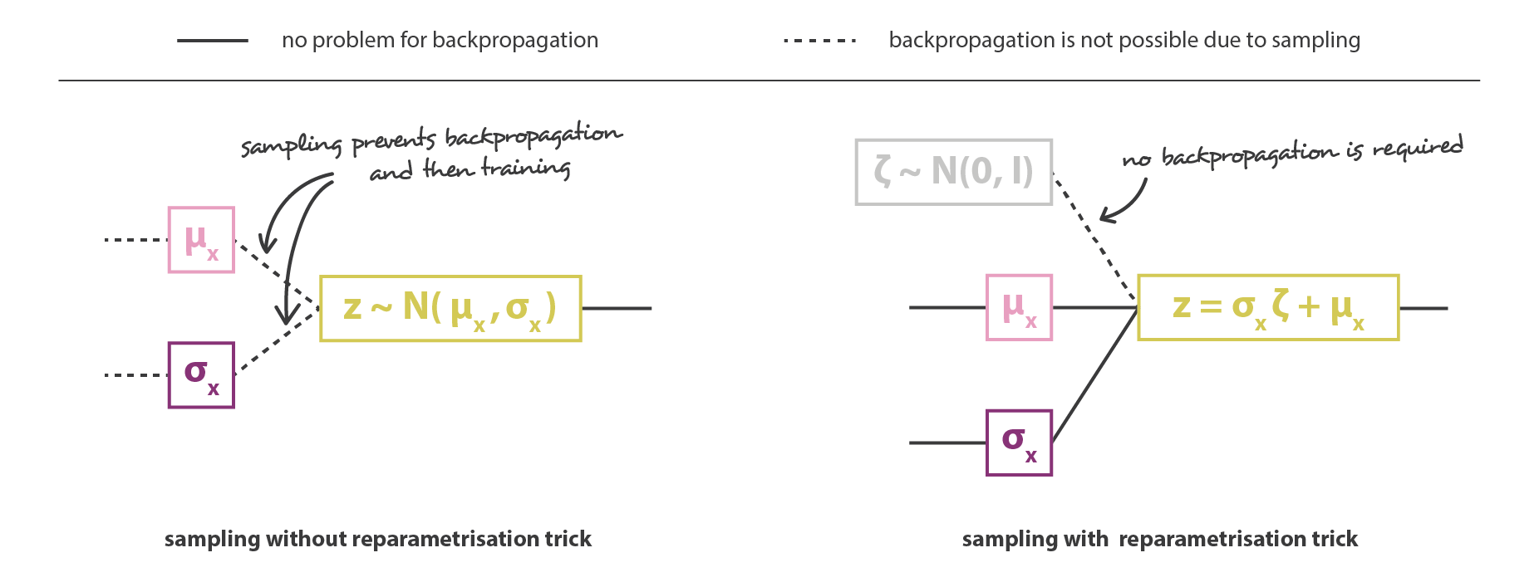
Variational Autoencoder
Source: Understanding Variational Autoencoders (VAEs)
Notes:
reparametrisation trick

Slide 18
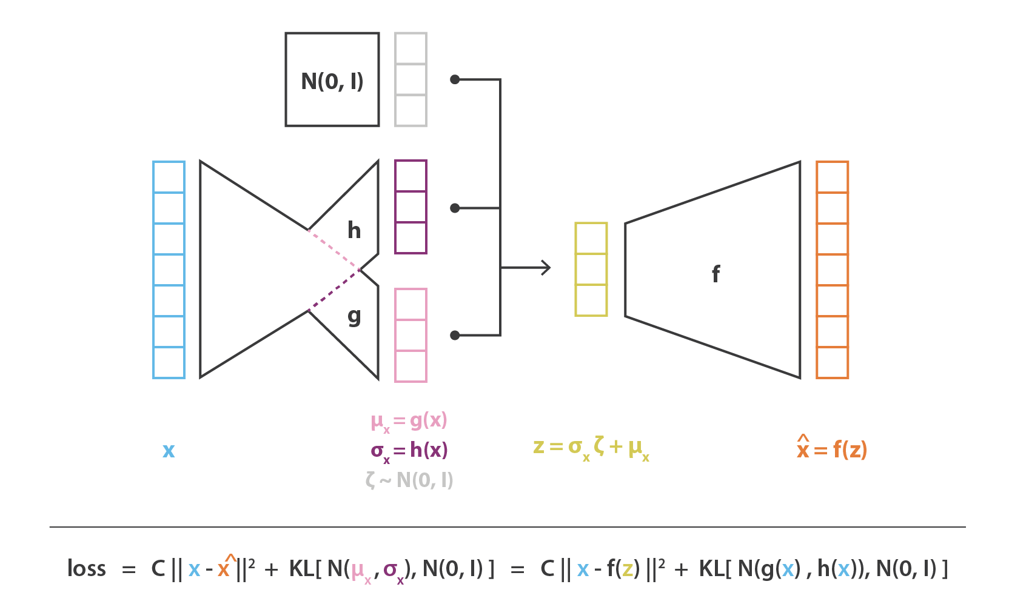

Slide 19
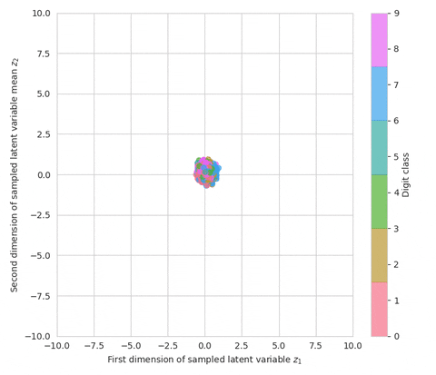
Source: https://giphy.com/gifs/
Notes:
https://giphy.com/gifs/vae-lqq0em9cuivVNWFwSX?utm_source=iframe&utm_medium=embed&utm_campaign=Embeds&utm_term=https%3A%2F%2Fjaan.io%2F

Slide 20
Implementation
Clustering
Generating
Recommendation

Slide 21
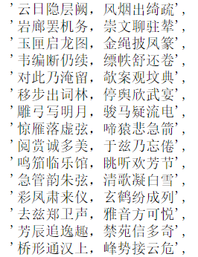
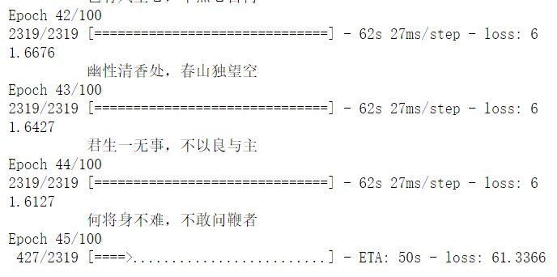
Example
Some of the inputs
Some of the outputs

Slide 22
Reference
Understanding Variational Autoencoders (VAEs)
Tutorial - What is a variational autoencoder?
Variational Autoencoders
Autoencoder-wiki
giphy.com
Kingma, D. P., & Welling, M. (2013). Auto-encoding variational bayes. arXiv preprint arXiv:1312.6114.
Pu, Y., Gan, Z., Henao, R., Yuan, X., Li, C., Stevens, A., & Carin, L. (2016). Variational autoencoder for deep learning of images, labels and captions. arXiv preprint arXiv:1609.08976.

